Slide 1
ChoreDash Final Presentation
The Jobblers: Kevin Ajili, Mike Hamilton, Vikram Melkote, Grant Lin, Jimmy (Duy) Nguyen
December 2017

Slide 2
Introduction
Motivation:
We wanted to make an application that would allow students who were too lazy to get their chores done to pay other students to do it for them.
What is ChoreDash:
ChoreDash is a student-student web application that allows students to list and accept certain chores/jobs by other students in their college community.

Slide 3
Overarching Goal
Create a fully interactive web application with lots of useful functionality

Slide 4
Goals We Achieved
Created encrypted login system
Restricted sign up to @ucsc.edu emails
Created a profile page with editing features
Create posting page with editing features
Implemented Google Maps API for autofill location

Slide 5
Goals We Did Not Achieve
Responsive job request/accept/decline
Getting directions to job
Rating hirees
Job management page
Messaging/chat
Reminders/notifications

Slide 6
Challenges
Learning the new technologies
Time management
Finding time to work collaboratively
Working on weekends

Slide 7
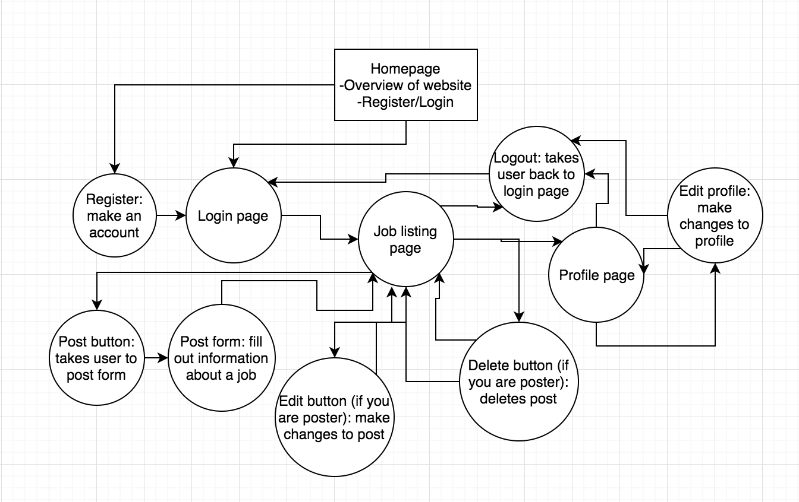
System Overview

Slide 8
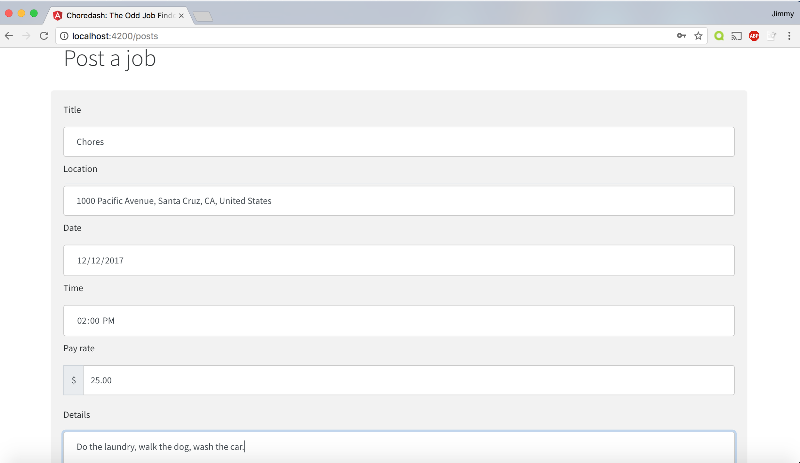
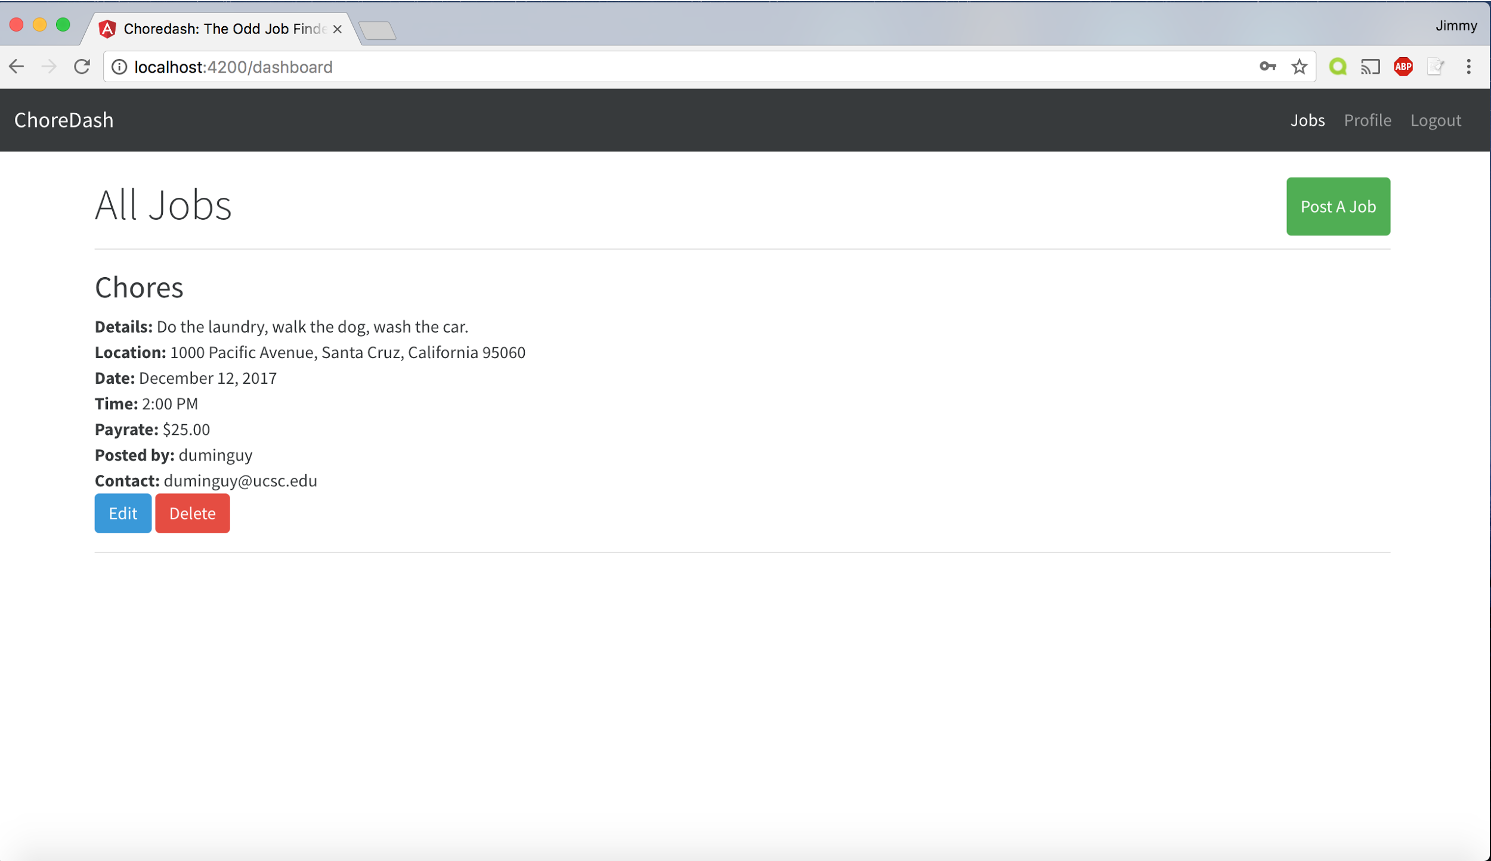
System Screenshots

Slide 9





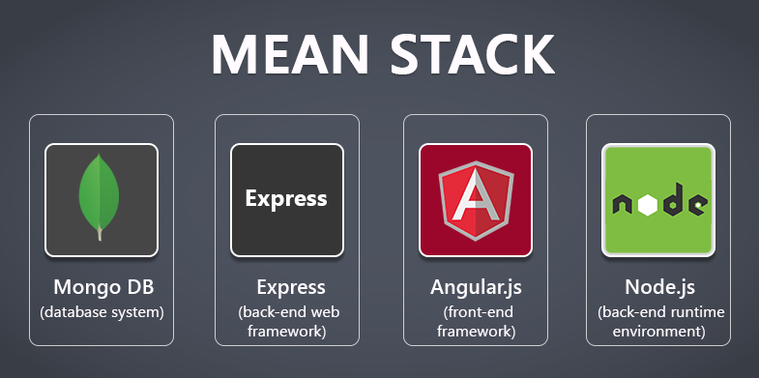
Technologies
Node.js
Backend runtime, allows javascript to be run on server-side
Angular.js
Front end framework client uses to see html components
Express
Back end HTTP framework
MongoDB
NoSQL database used for data storage

Slide 10
MEAN Stack Components
Browser
MongoDB
Angular.js
Node.js
Express
User request
Server write / read request

Slide 11
Project Management Techniques
Scrum Meetings
Helped everyone stay updated with what each team member is doing
Scrum Board (Trello)
Helped the team remain updated on what the current progress of the project is
Group Coding
Helped in completing certain tasks in an efficient manner
Discord
Helped the team remain in constant communication
Github
Helped keep documentation and version control

Slide 12
Things We Enjoyed/Didn’t Enjoy
Enjoyed:
Working as a group/team and seeing something come to fruition
Learning new technologies
Didn’t Enjoy:
Finding time that accommodated to everyone’s needs
Lack of communication at times

Slide 13
Lessons Learned
Communication is key
Lack of communication can lead to no progress being made
Good teamwork/collaboratively working is beneficial
Leads to more work being done in shorter periods of time
Having a clear idea of the user’s requirements of a feature is extremely helpful in understanding how to go about implementing it and how to prioritize relevant tasks

Slide 14
Thanks!
Questions?

